Slide 1

Babak Emami,
Emami.Babak@gmail.com
647-326-6199

Slide 2
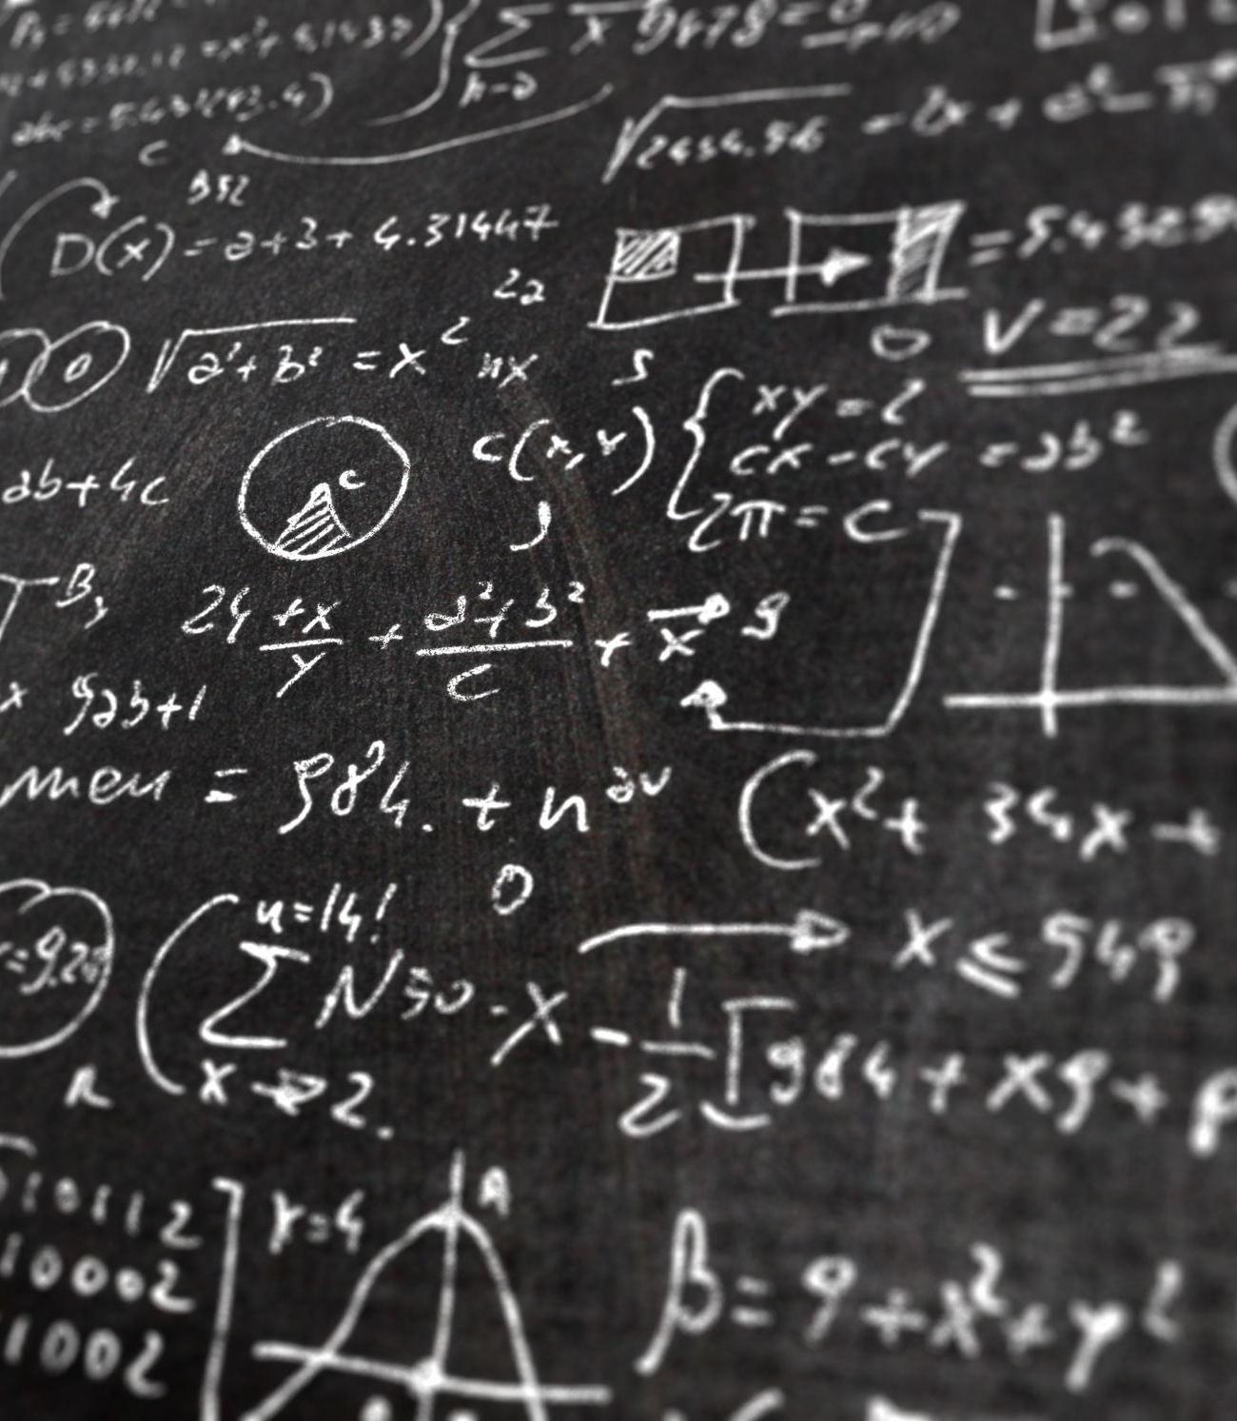
Introduction to Data optimization Dimensionality Reduction Techniques
For taking this session, you just need to remember the basics of linear algebra, which you have learned during your high school and a little bit python programming! That’s it!
Requirements: python 3.6+ , anaconda and Jupyter notebook

Slide 3

Agenda
What is the Data Dimension :
How machine could understand our data
Why Data Optimization and Dimension Reduction :
Linear vs non-linear data
How to Select an Appropriated Dimension Reduction Technique
PCA
T-NSE
Workbook:
Python 3.6+ , anaconda and Jupyter notebook

Slide 4

What is the Data Dimension :
Any object will be represented by its characteristics.
The machine will use the same features to learn data and understand your request.
For example, when we are drinking , the quality of our Wine would be our target while this wine has been labeled as a high/medium or low quality because of its features:
Brand, color, price, year, shape, sweetness, Fixed acidity, Volatile acidity, Citric acid, Residual sugar, Chlorides, Free sulfur dioxide, Total sulfur dioxide, Density, pH, Sulfates, Alcohol

Slide 5

Why Data Optimization and Dimension Reduction :
In real-world problems would be represented with multiple features.
Working with such complex data with hundreds of thousands of features would be very undesired.
Data scientists, use some mathematical techniques, such as” Dimensionality Reduction”; to manipulate and transform it into a desired shape with the low-dimensional format.

Slide 6

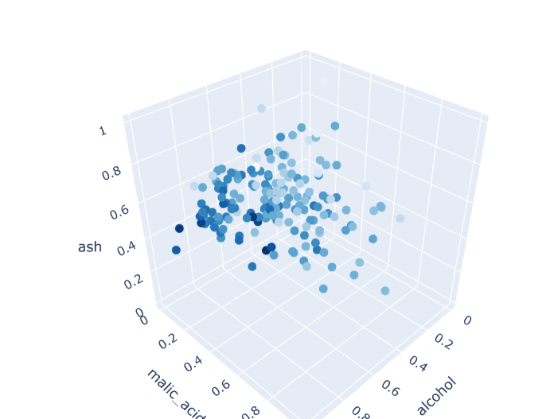
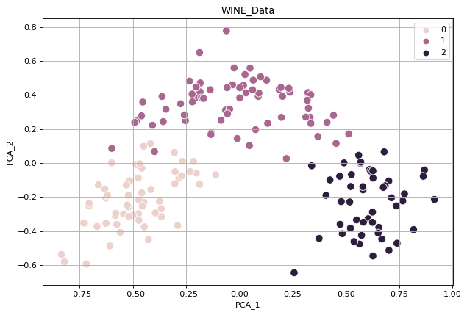
Dimension Reduction
Solving a Real Problem using Optimization Techniques

Slide 7
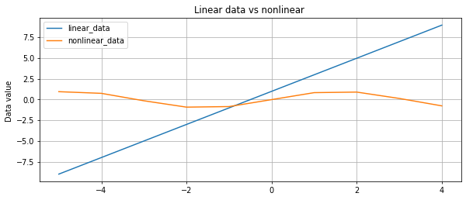

Linear and None Linear Data
Data with linear regression will be represented as linear data when the regression score would not be changed in any quadrant of the data series.
The results of the following function would be a linear series (y = ax+b)
If the series showed different correlation values in a different quadrant, the data would have a nonlinear regression value, like y = sin( x ) or y = $x^{2}$
X | linear data | nonlinear data
-5 | -9 | 0.958924
-4 | -7 | 0.756802
-3 | -5 | -0.14112
-2 | -3 | -0.909297
-1 | -1 | -0.841471
0 | 1 | 0
1 | 3 | 0.841471
2 | 5 | 0.909297
3 | 7 | 0.14112
4 | 9 | -0.756802

Slide 8

How to Select an Appropriated Dimension Reduction Technique
Methods are commonly divided into linear and nonlinear approaches. Depending on the dataset, we could use either linear techniques like PCA or nonlinear ones like T-NSE.
Linear methods for linear data.
PCA, FA, LDA and Truncated SVD are linear methods that could project the original data into a low-dimensional space.
Nonlinear method for nonlinear data
When the linear methods will not be performing well on nonlinear data, we could take advantage of such methods like Kernel PCA, t-SNE, MDS, and Isomap

Slide 9
Principal Component Analysis (PCA) Problem Formulation
Reduce from N-dimension to m-dimension:
The new variables/dimensions are linear and will not be correlated to the other variables.
Principal Component analysis (PCA): PCA is an unsupervised linear dimensionality reduction and data visualization technique for very high dimensional data. As having high dimensional data is very hard to gain insights from adding to that, it is very computationally intensive. The main idea behind this technique is to reduce the dimensionality of data that is highly correlated by transforming the original set of vectors to a new set which is known as Principal component.
PCA tries to preserve the Global Structure of data
converting N-dimensional data to M-dimensional data then it tries to map all the clusters as a whole due to which local structures might get lost. Application of this technique includes Noise filtering, feature extractions, stock market predictions, and gene data analysis.

Slide 10
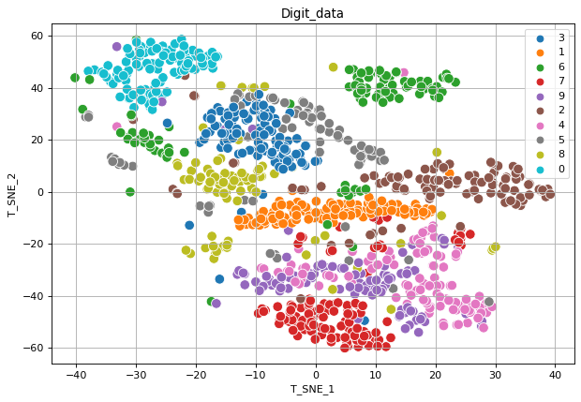
T-distributed Stochastic Neighborhood Embedding (t-SNE)Problem Formulation
t-SNE is also an unsupervised non-linear dimensionality reduction and data visualization technique. The math behind t-SNE is quite complex but the idea is simple. It embeds the points from a higher dimension to a lower dimension trying to preserve the neighborhood of that point.
t-distribution
The t distribution is a probability distribution scores that is similar to the normal distribution except it has heavier “tails” than the normal distribution
Unlike PCA it tries to preserve the Local structure of data by minimizing the Kullback–Leibler divergence (KL divergence) between the two distributions with respect to the locations of the points in the map. This technique finds application in computer security research, music analysis, cancer research, bioinformatics, and biomedical signal processing.

Slide 11
Table of Difference between PCA and t-SNE
 | PCA | t-SNE
1 | linear | non-linear
2 | It tries to preserve the global structure of the data. | It tries to preserve the local structure(cluster) of data.
3 | It does not work well as compared to t-SNE. | It is one of the best dimensionality reduction technique.
4 | It does not involve Hyperparameters. | It involves Hyperparameters such as perplexity, learning rate and number of steps.
5 | It gets highly affected by outliers. | It can handle outliers.
6 | PCA is a deterministic algorithm. | It is a non-deterministic or randomized algorithm.
7 | It works by rotating the vectors for preserving variance. | It works by minimizing the distance between the point in a gaussian.
8 | We can decide on how much variance to preserve using eigen values. | We cannot preserve variance instead we can preserve distance using hyperparameters.

Slide 12

Conclusion
We can use either Linear or nonlinear method to optimize our data.
By using dimension reduction techniques, we could visualize and reduce the data noises, detect the data outlier, manipulate data against overfitting,..
Linear method will not perform well on a nonlinear data

Slide 13

Thank you for the attention

